Slide 1




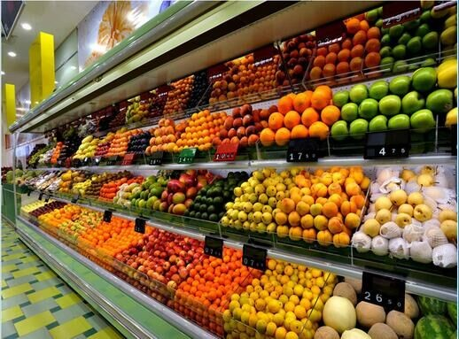
Assessing and Optimizing the Performance of
R-290 Integral Display Case

Slide 2



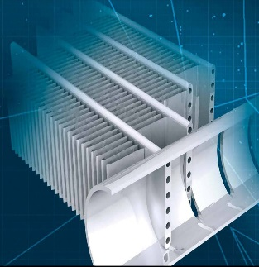

Contents
1
Introduction
2
Objectives
3
System Description
4
Data Analysis
5
Preliminary Simulations
6
Inquiries
2

Slide 3
1
Introduction

Slide 4

Mission
Assessing and optimizing the performance of the following R-290 integral display case.
The system comprises:
1 evaporator with 3 circuits of R290.
3 Copeland Scroll ZB09KAU-TFD compressors.
3 Danfoss D22-20 Micro-plate condensers.
4

Slide 5
Mission
Design point/working conditions:
Evaporation temperature: – 6 °C
Cooling capacity per compressor/circuit: 2.5 kW
Condensing temperature: 40 °C
Subcooling: 1 K
Superheat: 7 K to 10 K
Number of circuits: 3
Mass flow R-290 per circuit: 9.20 g/s
Tair,out: – 2 °C
Tair,in: 6 °C with 50% RH
5

Slide 6
2
Objectives

Slide 7
The main objectives could be summarized next:
To analyze the experimental data of the current system.
To model the current system using IMST-ART simulation tool in order to assess the system performance.
To optimize the whole system in order to reduce the refrigerant charge and pressure drop while maintain the display case dimensions.
7

Slide 8
3
System Description

Slide 9
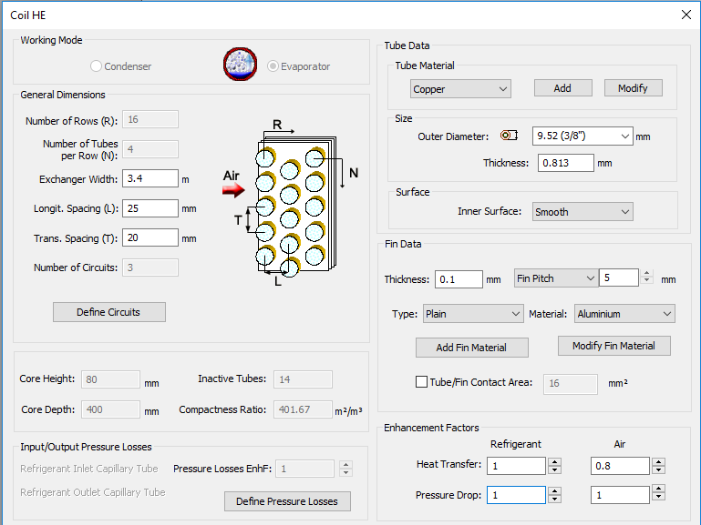
Evaporator
The current evaporator has the following dimensions:
9

Slide 10
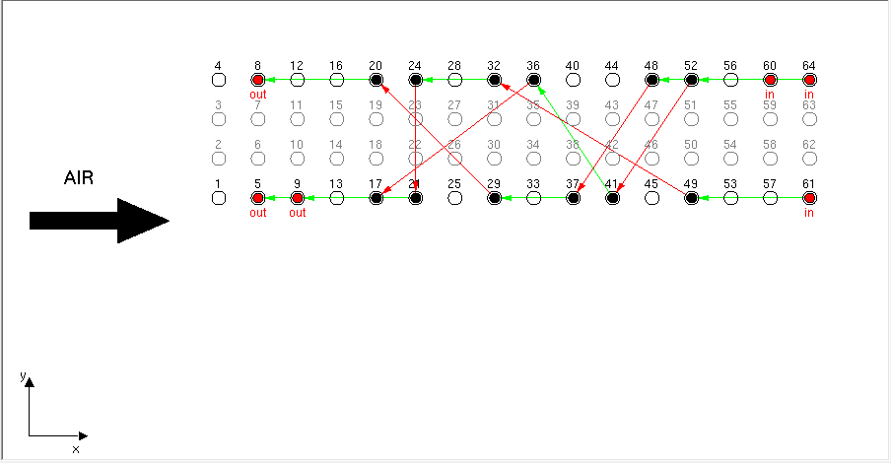
Evaporator
It has 3x 150g R290 circuits arranged as follows:
Inlet circuit 3 (C3)
Inlet circuit 2 (C2)
Inlet circuit 1 (C1)
Refrigeration Circuits by IMST-ART
10

Slide 11
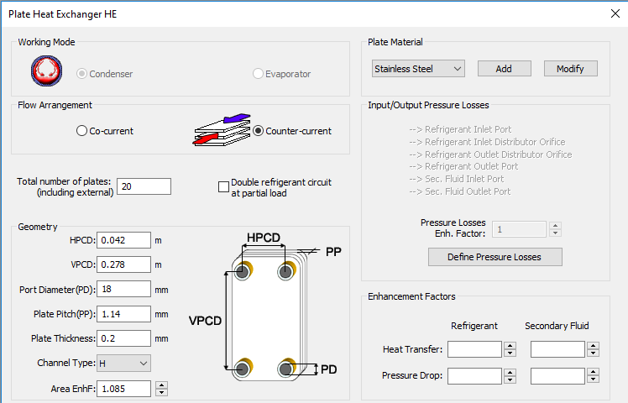
Condenser
The specifications of one condenser are:
11

Slide 12
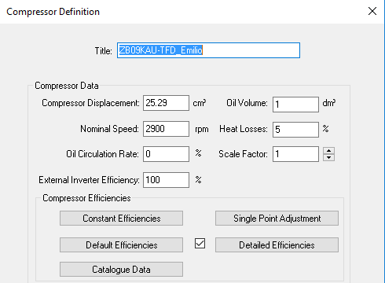
Compressor
The specifications of one compressor are:
12

Slide 13
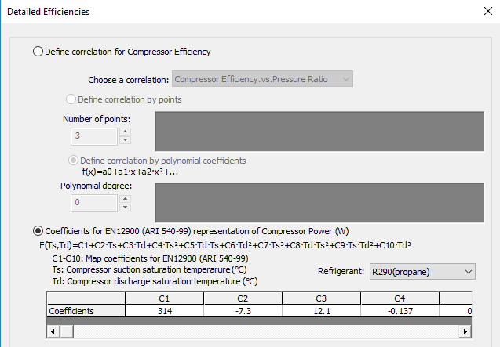
Compressor
The power correlation:
13

Slide 14
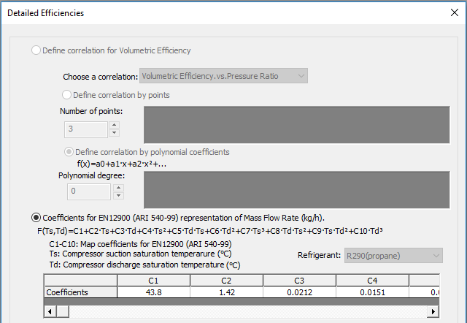
Compressor
The mass flow rate correlation:
14

Slide 15
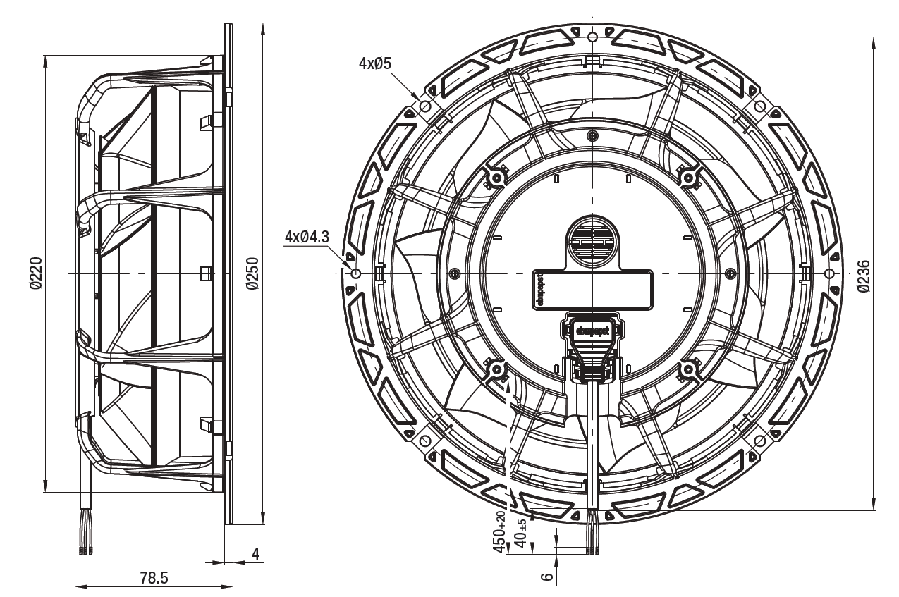
Evaporator Fans
The air flow is generated by 6 diagonal flow EC fans, model K1G-200 from EBM Papst running at 1400 rpm in the current arrangement.
The dimensions of one fan:
15

Slide 16
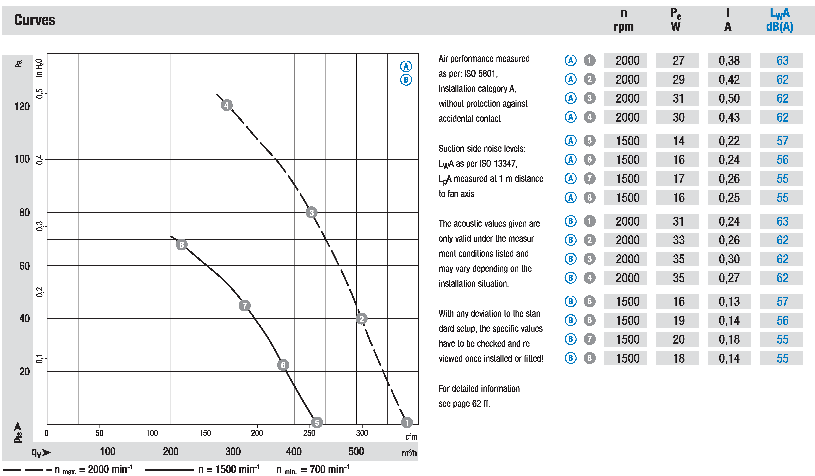
Evaporator Fans
The head vs flow rate curves are as follows:
16

Slide 17
4
Data Analysis

Slide 18
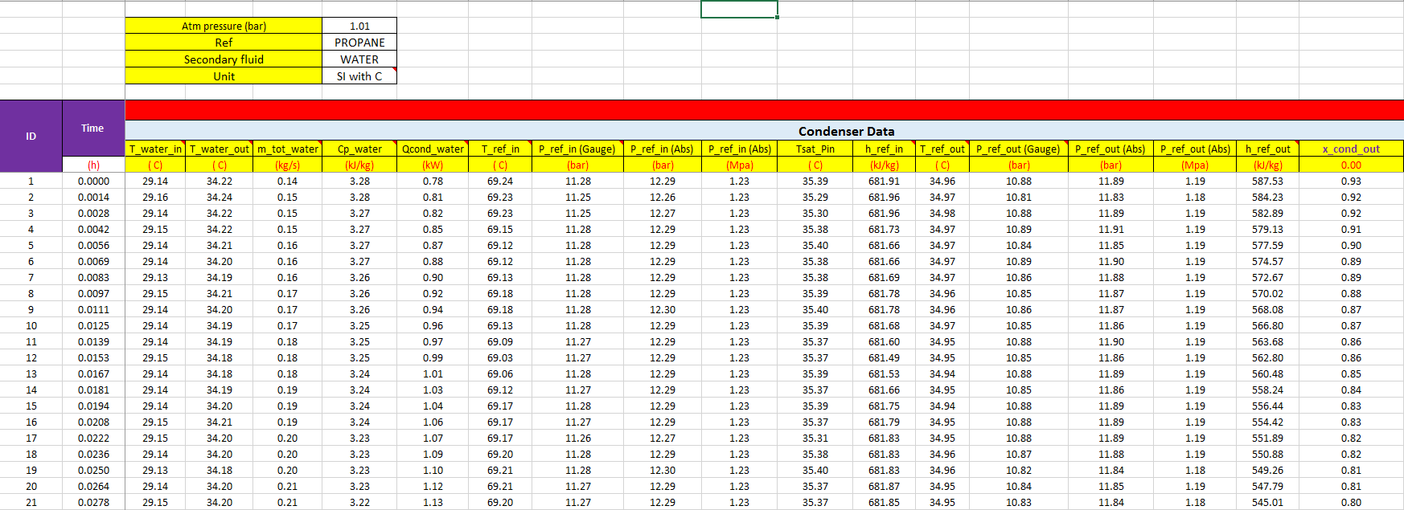
The experimental data has been rearranged and evaluated with REFPRO for each test point (Total number of points= 17278) as seen in the following Figures:
18

Slide 19
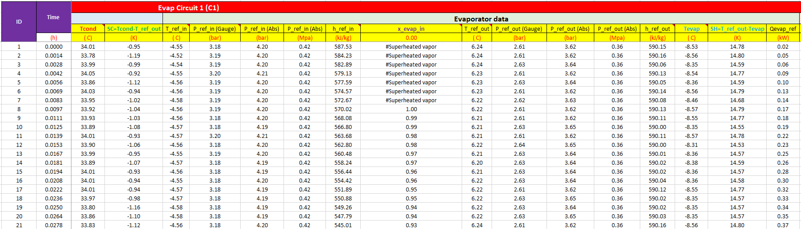
19

Slide 20
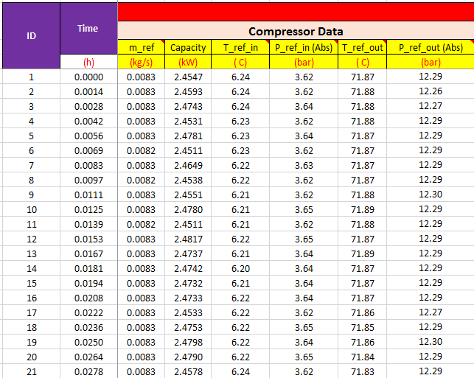
20

Slide 21
5
Preliminary Simulations

Slide 22
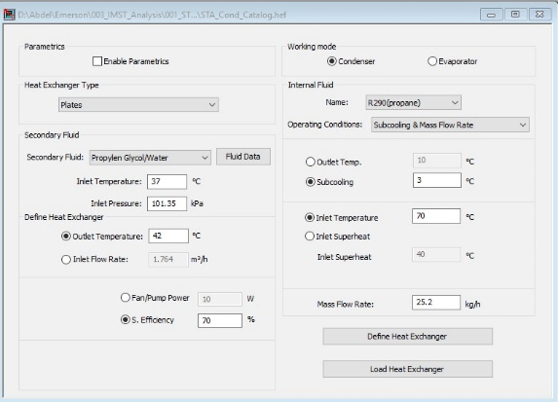
STA Analysis
Firstly, we have analyzed each system component separately to check the consistency between the numerical results and catalog or design data.
Standalone condenser analysis:
22

Slide 23
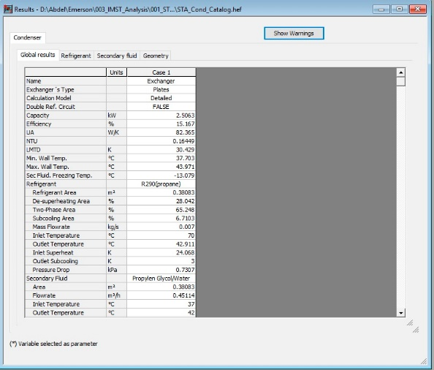
STA Analysis
Standalone condenser analysis (cont.):
23

Slide 24
STA Analysis
Standalone condenser analysis (cont.):
Parameter | IMST-ART | Catalog Data
Refrigerant Area (m²) | 0.38083 | 0.38
Inlet Sat. Temperature (C^{O}) | 45.932 | 44.71
Outlet Sat. Temperature (C^{O}) | 45.911 | 44.71
Capacity (kW) | 2.5063 | 2.5
Fluid Volume (L) | 0.17639 | 0.189
24

Slide 25
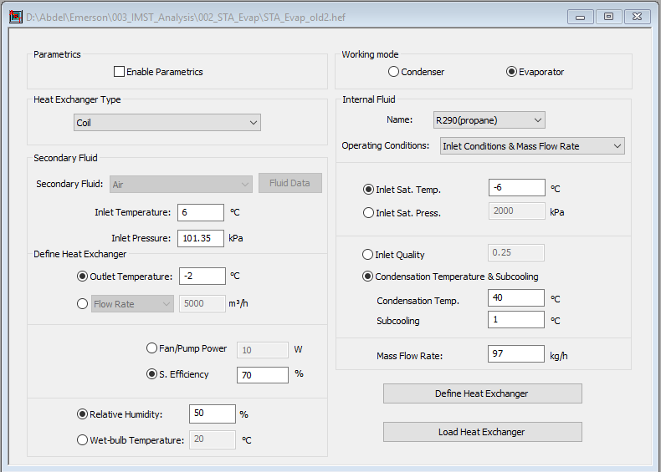
STA Analysis
Standalone evaporator analysis:
25

Slide 26
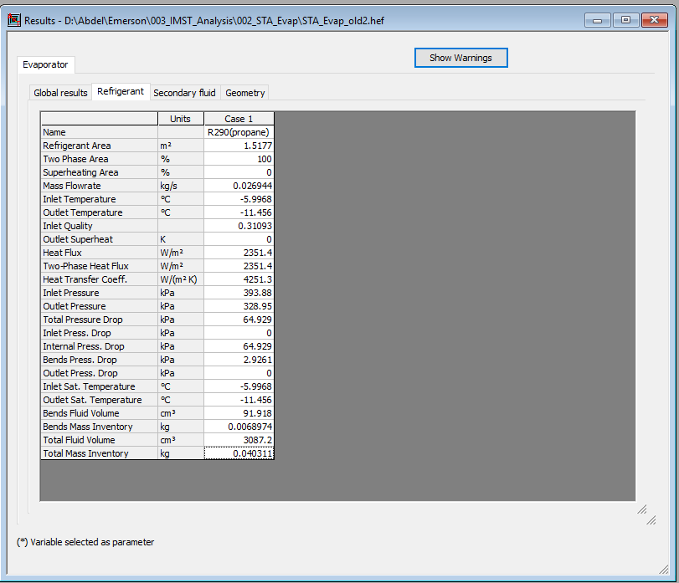
STA Analysis
Standalone evaporator analysis (cont.):
26

Slide 27
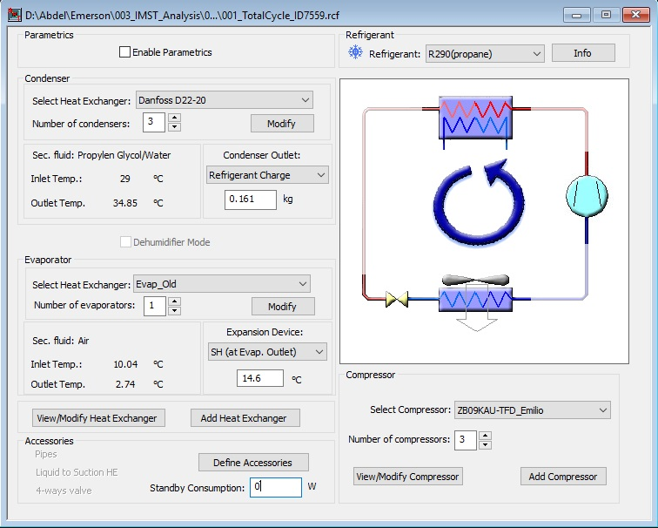
Real Cycle Analysis
Secondly, we have simulated the whole system on IMST-ART using the experimental data at specific point.
27

Slide 28
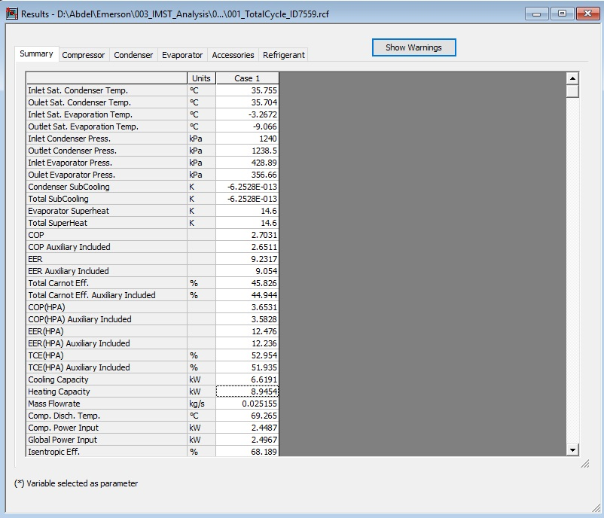
Real Cycle Analysis
We have made a parametric study to estimate the actual refrigerant charge which gives the outlet condenser enthalpy at this point.
28

Slide 29
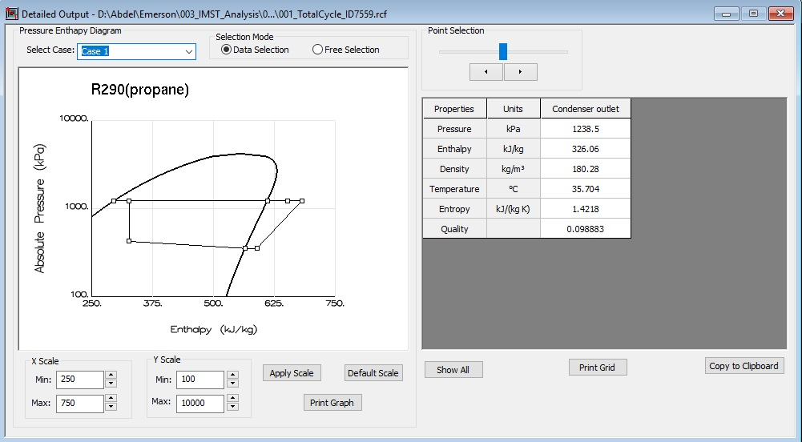
Real Cycle Analysis
29

Slide 30
6
Inquiries

Slide 31
To obtain an accurate evaluation of the system, we need some further information.
Our main inquires are listed below:
From the experimental data we have assumed that the secondary fluid used in the condenser is 30% propylene glycol + 70% water. Could you please confirm this?
Please, we need more data about the liquid line. This will result to a better estimation of the refrigerant charge.
We have assumed that the internal two tube rows of the evaporator were removed. Could you please confirm that issue? Also, we need to know the fin thickness and type.
Information about the expansion valve used in the current system.
31

Slide 32
Our main inquires are listed below (cont.):
Data about the air-side pressure drop.
Clarifying the required speed for evaporator fans, and the possibility of varying the fan speed.
Information regarding the oil capacity of the compressor, and the refrigerant solubility in oil.
Experimental data about the power consumed by the compressors.
Clarifying the actual refrigerant charge in the current system. Because from our preliminary simulations we have concluded that the charge is insufficient.
32

Slide 33
Our main inquires are listed below (cont.):
One way for optimizing the system is to increase the flow rate of secondary fluid used by condensers. So, could you confirm us the possibility of applying this solution for the current system?
If it is available, could you provide us with the thickness of plate used in the condensers.
33

Slide 34
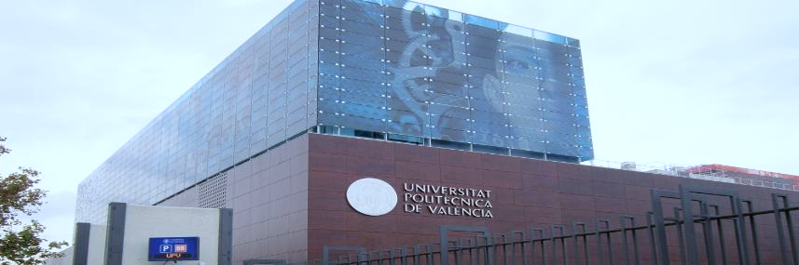


Thanks for Your Attention
Notes:
* And I´m I looking forward for your questions and inquiries.

